Slide 1

APEX INSTITUTE OF TECHNOLOGY
DEPARTMENT OF COMPUTER SCIENCE & ENGINEERING
Artificial Intelligence (20CSD-385)
Faculty: Ankur Sharma(E13693)
Lecture - 1
Introduction to Artificial Intelligence
DISCOVER . LEARN . EMPOWER

Slide 2
Artificial Intelligence : Course Objectives
COURSE OBJECTIVES
(AI) is a research field that studies how to realize the intelligent human behaviors on a computer. The ultimate goal of AI is to make a computer that can learn, plan, and solve problems autonomously. Although AI has been studied for more than half a century, we still cannot make a computer that is as intelligent as a human in all aspects, The main research topics in AI include: problem solving, reasoning, planning, natural language understanding, computer vision, automatic programming, machine learning, and so on. Of course, these topics are closely related with each other. In this course, we will study the most fundamental knowledge for understanding AI. We will introduce some basic search algorithms for problem solving; knowledge representation and reasoning; pattern recognition; fuzzy logic; and neural networks

Slide 3
COURSE OUTCOMES
On completion of this course, the students shall be able to:-
CO1 | Understand the basics of the theory and practice of Artificial Intelligence as a discipline and about intelligent agents capable of problem formulation

Slide 4
Unit-1 Syllabus
Unit-1
Ch1.Introduction to AI | Introduction Artificial Intelligence and its applications, Artificial Intelligence Techniques, Intelligent Agents, Nature of Agents, Learning Agents., advantages, and limitations of AI, Application of AI.
Ch2.Searching techniques | Problem solving techniques State space search, control strategies, Blind search
Ch3.Informed search | Heuristic search, problem characteristics, production system characteristics., Generate and test, Hill climbing, best first search, A* search, Constraint satisfaction problem.

Slide 5
SUGGESTIVE READINGS
TEXT BOOKS
T1. Artificial Intelligence: A Modern Approach by Stuart Russell and Peter Norvig. Prentice-Hall, 2003 (2ndEdition). T2. Elaine Riche, Kevin Knight and Shivashankar B. Nair, “Artificial Intelligence”, Third Edition, TMH Educations Pvt. Ltd., 2008
REFERENCE BOOKS
R1 Nils J. Nilsson, “The Quest for Artificial Intelligence”, Second Edition, Cambridge University Press, 2009
R2 Artificial Intelligence and Expert Systems – Dan W. Patterson, Prentice Hall of India

Slide 6
INTRODUCTION : What is AI
Artificial Intelligence is composed of two words Artificial and Intelligence, where Artificial defines "man-made," and intelligence defines "thinking power", hence AI means "a man-made thinking power.“
Artificial Intelligence exists when a machine can have human based skills such as learning, reasoning, and solving problems

Slide 7
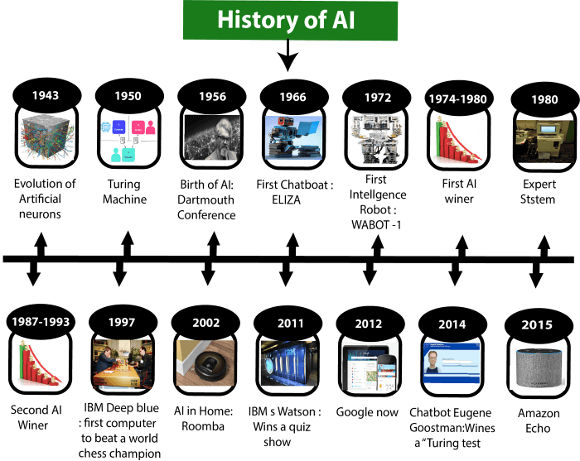
History of AI

Slide 8
Does AI have applications?
Autonomous planning and scheduling of tasks aboard a spacecraft
Beating Gary Kasparov in a chess match
Steering a driver-less car
Understanding language
Robotic assistants in surgery
Monitoring trade in the stock market to see if insider trading is going on

Slide 9
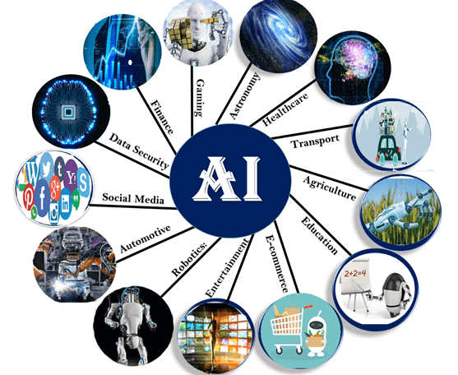
Applications

Slide 10
Goals of AI
Problem solving
Problem-solving agents:
In Artificial Intelligence, Search techniques are universal problem-solving methods. Rational agents or Problem-solving agents in AI mostly used these search strategies or algorithms to solve a specific problem and provide the best result.

Slide 11
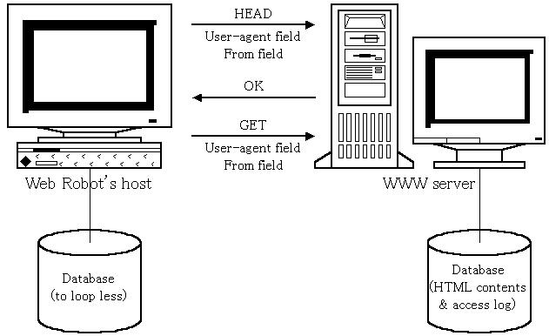

An Agent
Anything’ that can gather information about its environment and take action based on that information.

Slide 12
Agents
An agent is anything that can be viewed as perceiving its environment through sensors and acting upon that environment through actuators
Human agent: eyes, ears, and other organs for sensors; hands,
legs, mouth, and other body parts for actuators
Robotic agent: cameras and infrared range finders for sensors;
various motors for actuators

Slide 13
The World Model
Perception function
World dynamics / State transition function
Utility function- how does the agent know what constitutes “good” or “bad” behavior.

Slide 14
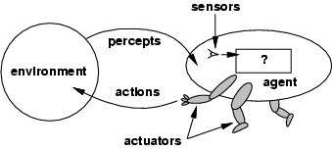
Agents and environments
The agent function maps from percept histories to actions:
[f: P* → A]
The agent program runs on the physical architecture to produce f
agent = architecture + program

Slide 15
Environments
Accessible/Inaccessible
Deterministic/Non-deterministic
Static/Dynamic
Discrete/Continuous
E.g. Driving a car, a game of Chinese-checkers

Slide 16
Agents
Reactive agents
No memory
Agents with memory

Slide 17
What is an (Intelligent) Agent?
An over-used, over-loaded, and misused term. Anything that can be viewed as perceiving its environment through sensors and acting upon that environment through its effectors to maximize progress towards its goals.
• Perception
• Sensors receive input from environment
• Keyboard clicks
• Camera data
• Action
• Actuators impact the environment
• Move a robotic arm
• Generate output for computer display

Slide 18
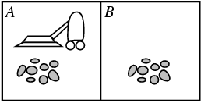
Vacuum-cleaner world
Percepts: location and contents, e.g., [A,Dirty]
Actions: Left, Right, Suck, NoOp

Slide 19
Rational agents
Rational Agent: For each possible percept sequence, a rational agent should select an action that is expected to maximize its performance measure, given the evidence provided by the percept sequence and whatever built-in knowledge the agent has.
An agent should strive to "do the right thing", based on what it can perceive and the actions it can perform. The right action is the one that will cause the agent to be most successful
Performance measure: An objective criterion for success of an agent's behavior
E.g., performance measure of a vacuum-cleaner agent could be amount of dirt cleaned up, amount of time taken, amount of electricity consumed, amount of noise generated, etc.
Rational Agent: For each possible percept sequence, a rational agent should select an action that is expected to maximize its performance measure, given the evidence provided by the percept sequence and whatever built-in knowledge the agent has.

Slide 20
PEAS
Must first specify the setting for intelligent agent design
Consider, e.g., the task of designing an automated taxi driver:
Performance measure: Safe, fast, legal, comfortable trip, maximize profits
Environment: Roads, other traffic, pedestrians, customers
Actuators: Steering wheel, accelerator, brake, signal, horn
Sensors: Cameras, sonar, speedometer, GPS, odometer, engine sensors, keyboard
PEAS: Performance measure, Environment, Actuators, Sensors
Must first specify the setting for intelligent agent design
Consider, e.g., the task of designing an automated taxi driver:
Performance measure
Environment
Actuators
Sensors

Slide 21
Environment types
Chess with Chess without Taxi driving
a clock a clock
Fully observable Yes Yes No
Deterministic Strategic Strategic No
Episodic No No No
Static Semi Yes No
Discrete Yes Yes No
Single agent No No No
The environment type largely determines the agent design
The real world is (of course) partially observable, stochastic, sequential, dynamic, continuous, multi-agent

Slide 22
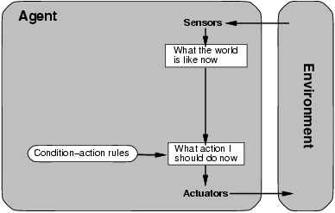
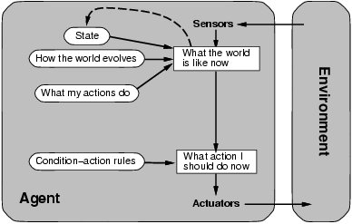
Agent types
Four basic types in order of increasing generality:
Simple reflex agents
Model-based reflex agents

Slide 23
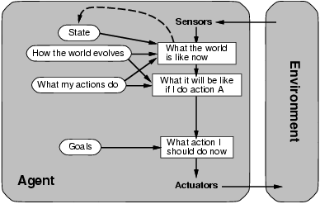
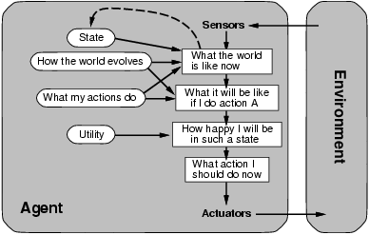
Goal-based agents
Utility-based agents

Slide 24
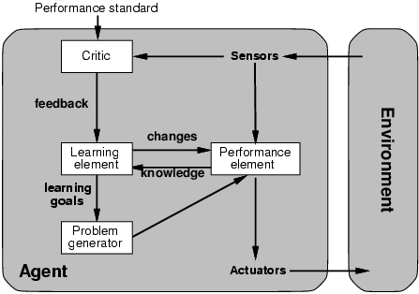
Learning agents

Slide 25
Assessment Questions
What do you mean by AI? Discuss its advantages and disadvantages.
Explain 3 main applications of AI in Current era .

Slide 26
REFERENCES
Artificial Intelligence: A Modern Approach by Stuart Russell and Peter Norvig. Prentice-Hall, 2003 (2nd Edition).

Slide 27
THANK YOU
For queries
Email: Ankur.e13693@cumail.in

